Slide 1
Gaussian Processes for Machine Learning
NEIL LAWRENCE
UNIVERSITY OF SHEFFIELD
@lawrennd
Notes:
Challenges
Introduce self
Alphago impressive but requires heavy compute.
More games of go than any human
And yet still Lee managed to win a match.

Slide 2
GLOBAL INFORMATION STORAGE CAPACITY IN OPTIMALLY COMPRESSED BYTES
SVMs
dominate
NIPS
ConvNets
Developed
Notes:
Superhuman performances are being driven by ML
Vision, Speech, Translation
Lots of process, but driven by availability of data.
Methodologies have not progressed a great deal since late 1990s

Slide 3
Notes:
Historical Analogy
Thomas Newcomen South West England
1712 Steam Engine

Slide 4
Coal
Google
Facebook
Amazon
Tin
Startups

Slide 5
Notes:
James Watt Separate Condensor 1760s

Slide 6
The Data are Not Enough
Four pillars:
Deterministic/Stochastic
Mechanistic/Emipirical
Goal: model complex phenomena over time
Problem:
Mechanistic models are often inaccurate
Data is often not rich enough for an empirical approach
Question 1: How do we combine inaccurate physical model with machine learning?

Slide 7
Central Dogma
DNA
Transcription
mRNA
Translation
Protein
Notes:
In this slide I’m going to use the layered model of network systems to describe the challenges of understanding complex systems in the physical world such as biological systems and neuroscience. I’ll give an analogy: imagine trying to understand the internet when you only have measurements of the cables and access to YouTube.

Slide 8
Decision: Transcription Factors
Measured using Microarray since 1998
mRNA
Translation
Difficult to measure
TF Protein
Transcription
Measured using Microarray since 1998
Other mRNAs
Notes:
In this slide I’m going to use the layered model of network systems to describe the challenges of understanding complex systems in the physical world such as biological systems and neuroscience. I’ll give an analogy: imagine trying to understand the internet when you only have measurements of the cables and access to YouTube.

Slide 9

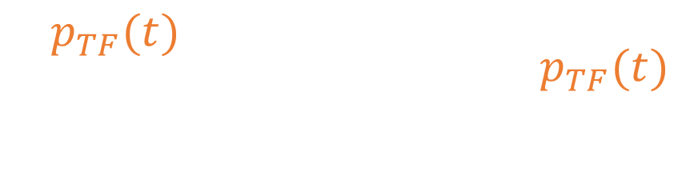



Mechanistic Model
mRNA $m_{TF}\left(t\right)$
$$\frac{ⅆp_{TF}(t) }{ⅆt}=s_{f}m_{TF}\left(t\right)−d_{f}p_{TF}(t)$$
Translation
TF Protein $p_{TF}(t)$
$$\frac{ⅆm_{i}(t)}{ⅆt}=s_{i}p_{TF}(t)−d_{i}m_{i}(t)$$
Transcription
Other mRNAs $m_{i}(t)$

Slide 10
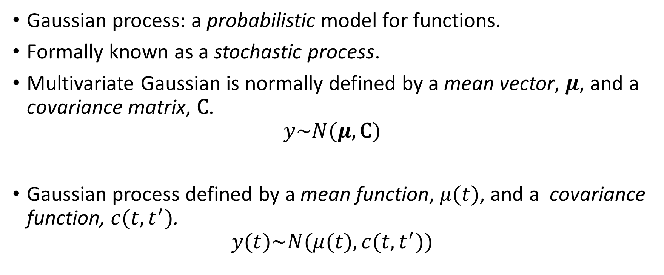

Need to Model $p_{TF}(t)$
Gaussian process: a probabilistic model for functions.
Formally known as a stochastic process.
Multivariate Gaussian is normally defined by a mean vector, $μ$, and a covariance matrix, $\text{C}$.
$$y\sim N(μ,\text{C})$$
Gaussian process defined by a mean function, $μ(t)$, and a covariance function, $c(t,t^{′})$.
$$y(t)\sim N(μ(t),c(t,t^{′}))$$

Slide 11






Zero Mean Gaussian Sample
Zero Mean Gaussian Process Sample
index
$$t^{′}$$
5
10
15
20
25
2
1
0.9
1.5
5
0.8
0.7
1
$$y(t)$$
10
0.6
$$\text{y}$$
index
$$t$$
0.5
0.5
15
0.4
0.3
0
20
0.2
0.1
25
0
5
10
15
20
25
index
t
covariance $\text{C}$
covariance function $c(t,t^{′})$
samples from Gaussian
samples from Gaussian process

Slide 12






Gaussian Processes
$$x_{1},y_{1}$$
$${x_{2},y}_{2}$$
$$p\left(f | x\right)$$
$$p\left(y_{1}|f_{1}\right)$$
$$p\left(f|y,x\right)$$
$$p\left(y_{2}|f_{2}\right)$$

Slide 13
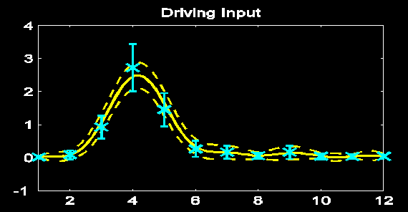
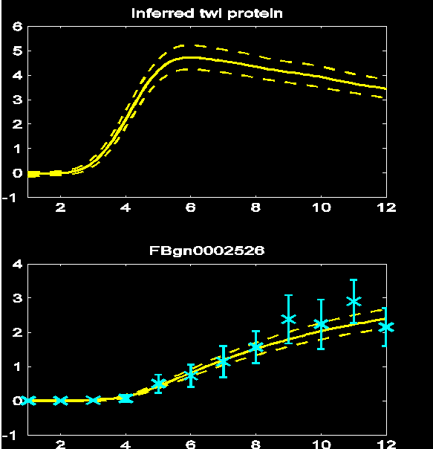




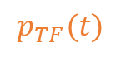
Results
$$m_{TF}\left(t\right)$$
$$\frac{ⅆp_{TF}(t) }{ⅆt}=s_{f}m_{TF}\left(t\right)−d_{f}p_{TF}(t)$$
$$p_{TF}(t)$$
$$\frac{ⅆm_{i}(t)}{ⅆt}=s_{i}p_{TF}(t)−d_{i}m_{i}(t)$$
$$m_{i}(t)$$
TPAMI, 2 PNAS papers, 2 Comp Bio

Slide 14
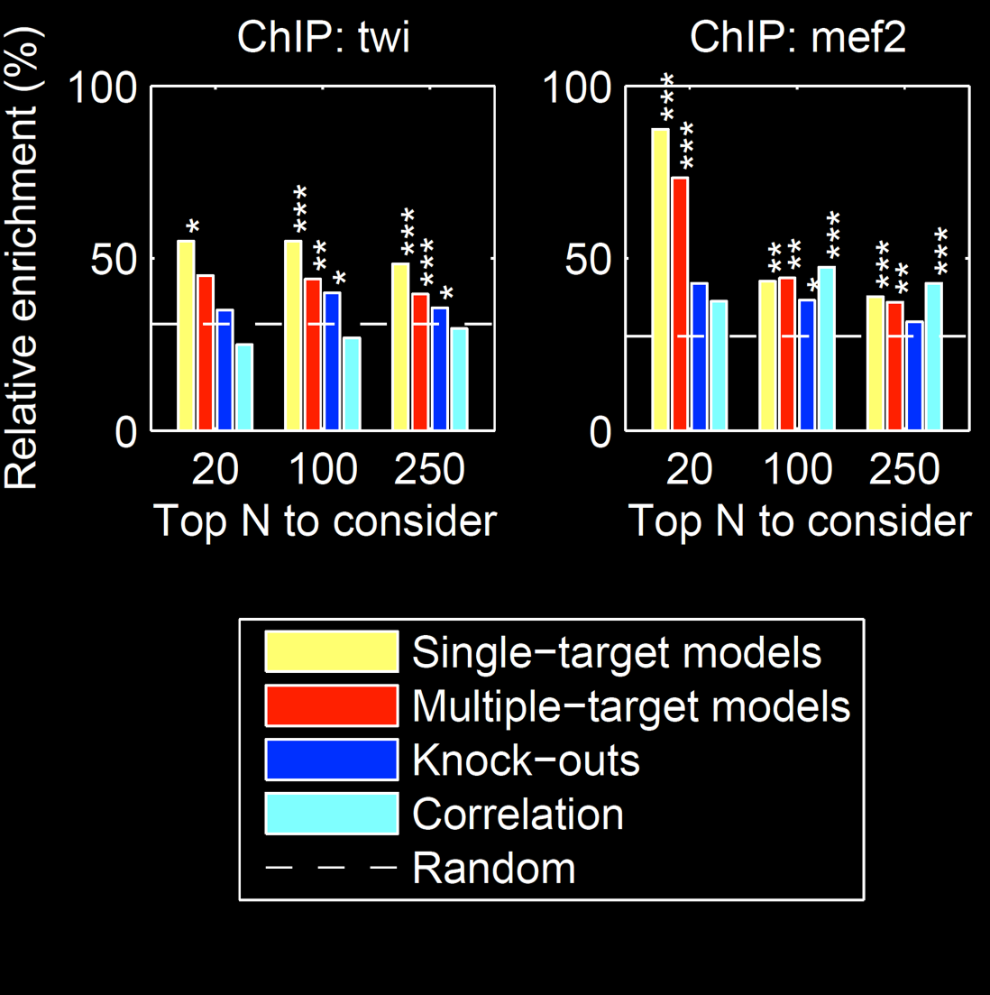

Slide 15
MATLAB Demo
demo_2016_04_28_amazon.m

Slide 16
Further Challenge
This model inter-relates different functions with mechanistic understanding.
What if you need to inter-relate across different modalities of data at different scales.
E.g. biopsy images + genetic test + mammogram for breast cancer diagnostics.

Slide 17
The Data are Not Enough
Four pillars:
Deterministic/Stochastic
Mechanistic/Empirical
Goal: model complex phenomena over time
Problem:
Mechanistic models are often inaccurate
Data is often not rich enough for an empirical approach
Question 2: How do we formulate the right representations to integrate different data modalities?

Slide 18


Classical Latent Variables
$$\text{x}$$
$$\text{y}$$

Slide 19

Classical Treatment
Assume a priori that
$$x\sim N\left(0,I\right)$$
Relate linearly to $\text{y}$
$$\text{y} \text{=} \text{Wx} \text{+}ε$$
Framework covers many classical models PCA, Factor Analysis, ICA

Slide 20
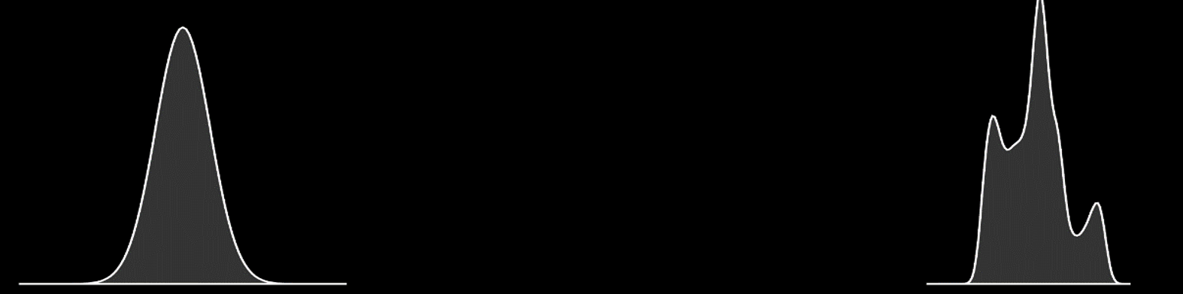
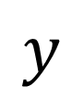
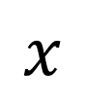

Render Gaussian Non Gaussian
$$y=f(x)$$
$$x$$
$$y$$
Notes:
In practice, many things are non gaussian, here I’ll introduce the idea of process composition: deep Gaussian processes, which we intend to use to deal with the Non Gaussian and abstract nature of the data. I’ll relate it to the OSI model and suggest that abstraction in this way, with propagation of uncertainty is a promising approach to phenomological modelling at multiple levels.

Slide 21
Use Abstraction for Complex Systems
High Level Ideas
Stratification of Concepts
Low Level Mechanisms
Notes:
In this slide I’m going to use the layered model of network systems to describe the challenges of understanding complex systems in the physical world such as biological systems and neuroscience. I’ll give an analogy: imagine trying to understand the internet when you only have measurements of the cables and access to YouTube.

Slide 22
Notes:
People and entire fields are passed by.

Slide 23
Biology and Health
Health
? ? ?
Molecular Biology
Notes:
Relate it to the situation in health where many of the intermediate layers are known. Einstein’s work was like a two layer system. How do we deal with multiple layers of abstraction.

Slide 24
Neuroscience
Behaviour
? ? ?
Neuron Firing
Notes:
Similar for the brain and behaviour. We are an an interesting juncture where the tools we use to develop our understanding of abstraction will be necessary for also unpicking function in the brain.

Slide 25











$\text{g}\left(x\right)$
${\text{f}}_{1}(x)$
${\text{f}}_{2}(∙)$
${\text{f}}_{3}(∙)$
${\text{f}}_{4}(∙)$
${\text{f}}_{5}(∙)$
${\text{f}}_{6}(∙)$
${\text{f}}_{7}(∙)$
${\text{f}}_{8}(∙)$
${\text{f}}_{9}(∙)$
$\text{g}\left(x\right)={\text{f}}_{9}\left({\text{f}}_{8}\left({\text{f}}_{7}\left({\text{f}}_{6}\left(⋯\right)\right)\right)\right)$

Slide 26
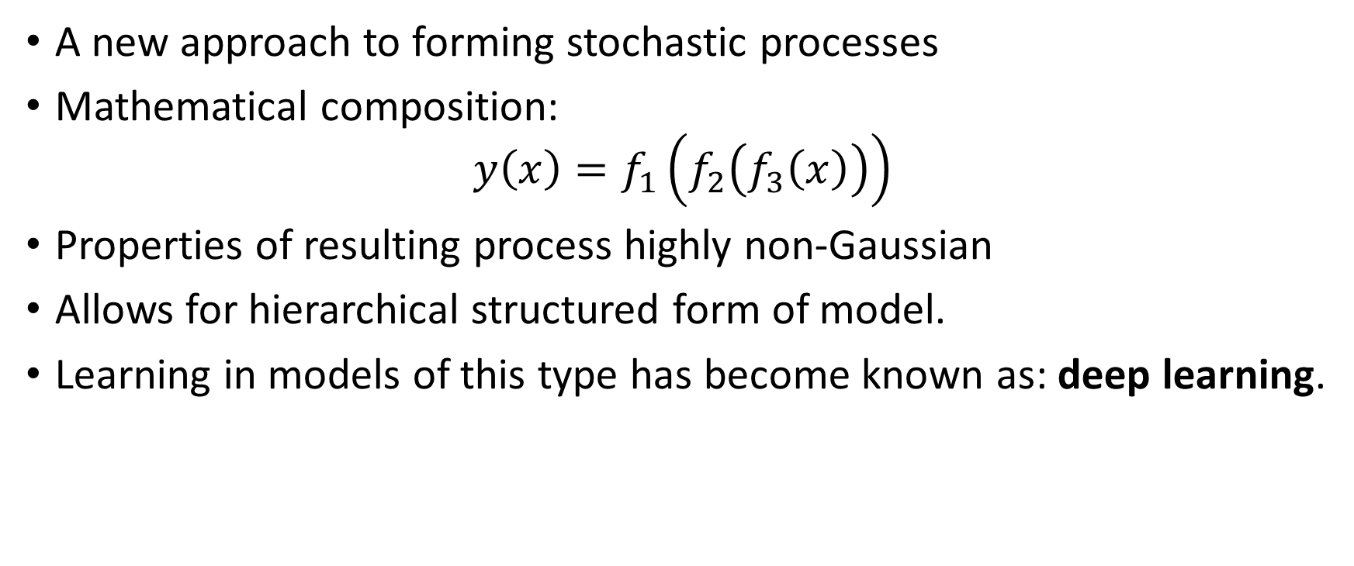
Stochastic Process Composition
A new approach to forming stochastic processes
Mathematical composition:
$$y\left(x\right)=f_{1}\left(f_{2}\left(f_{3}\left(x\right)\right)\right)$$
Properties of resulting process highly non-Gaussian
Allows for hierarchical structured form of model.
Learning in models of this type has become known as: deep learning.
Notes:
Non Gaussianity and structure achieved through the process of stochastic process composition. Leads to more flexible familiies of processes which can express more interesting beliefs about the system. Can be made to closely reflect the abstraction structure we referred to before.

Slide 27
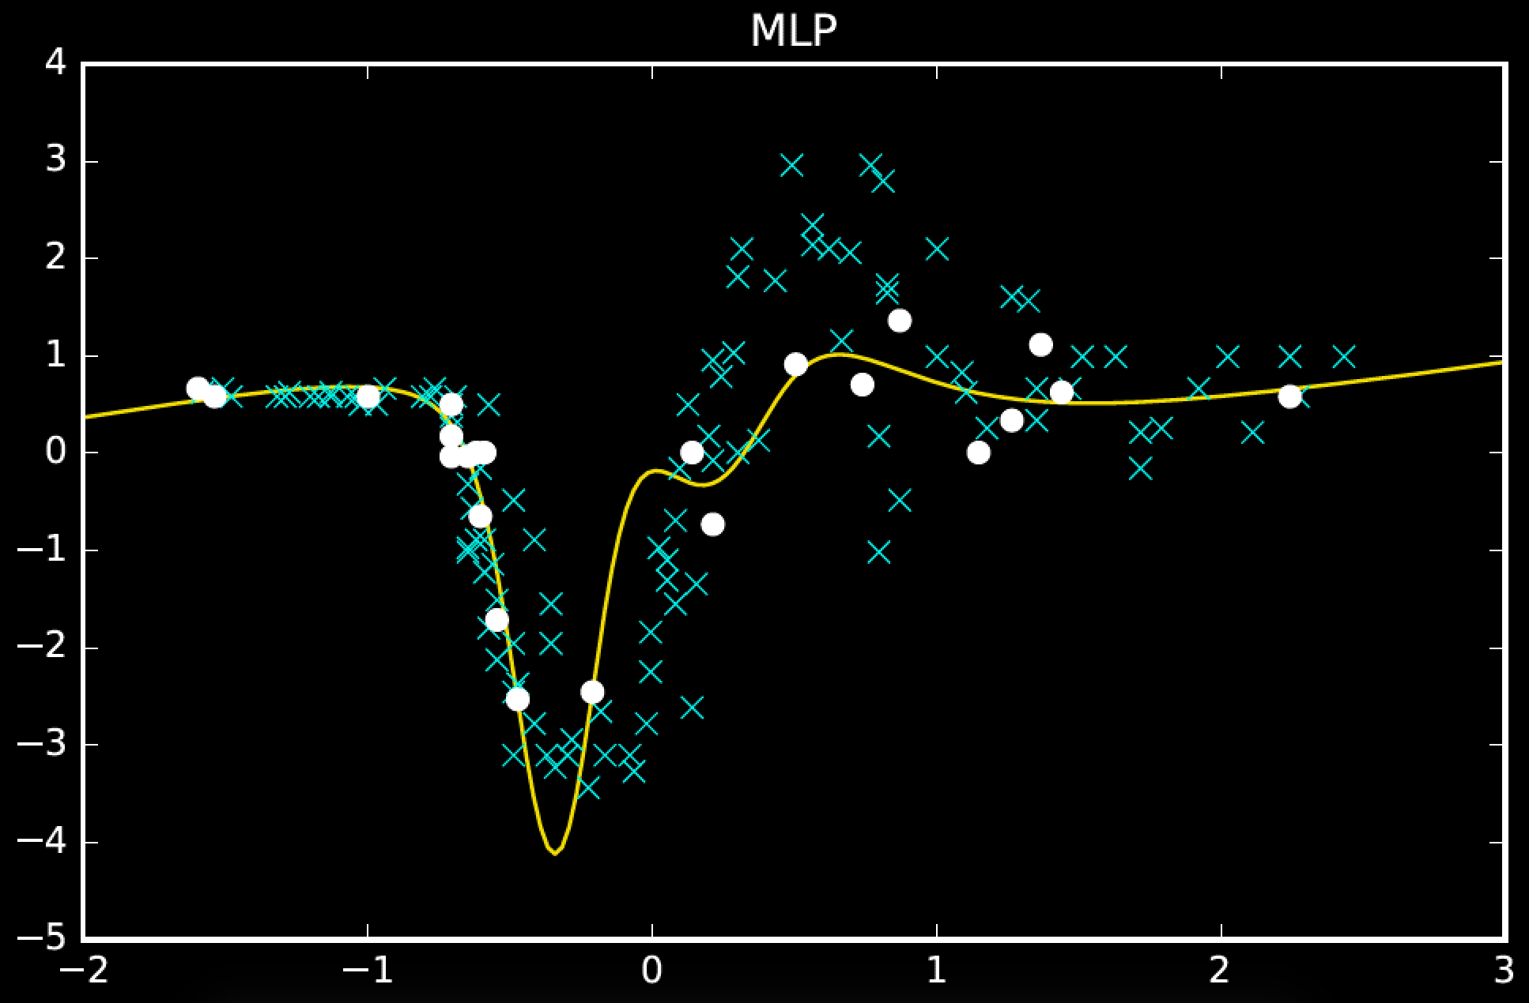
(200 iterations)

Slide 28
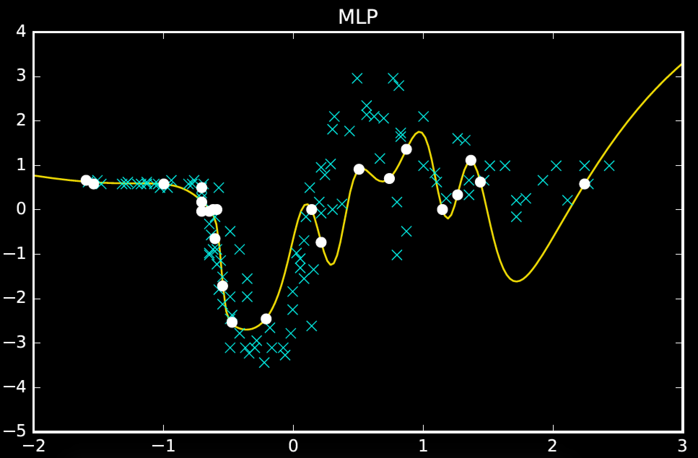
(converged)

Slide 29
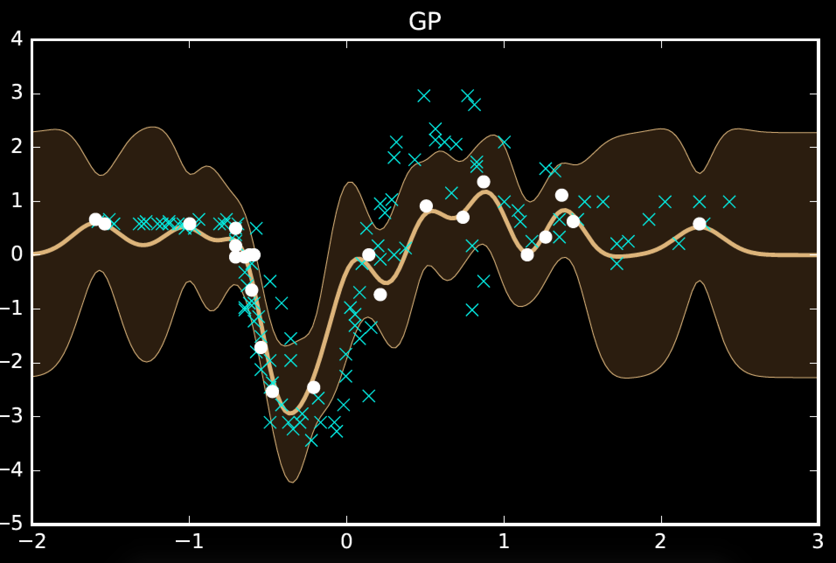

Slide 30
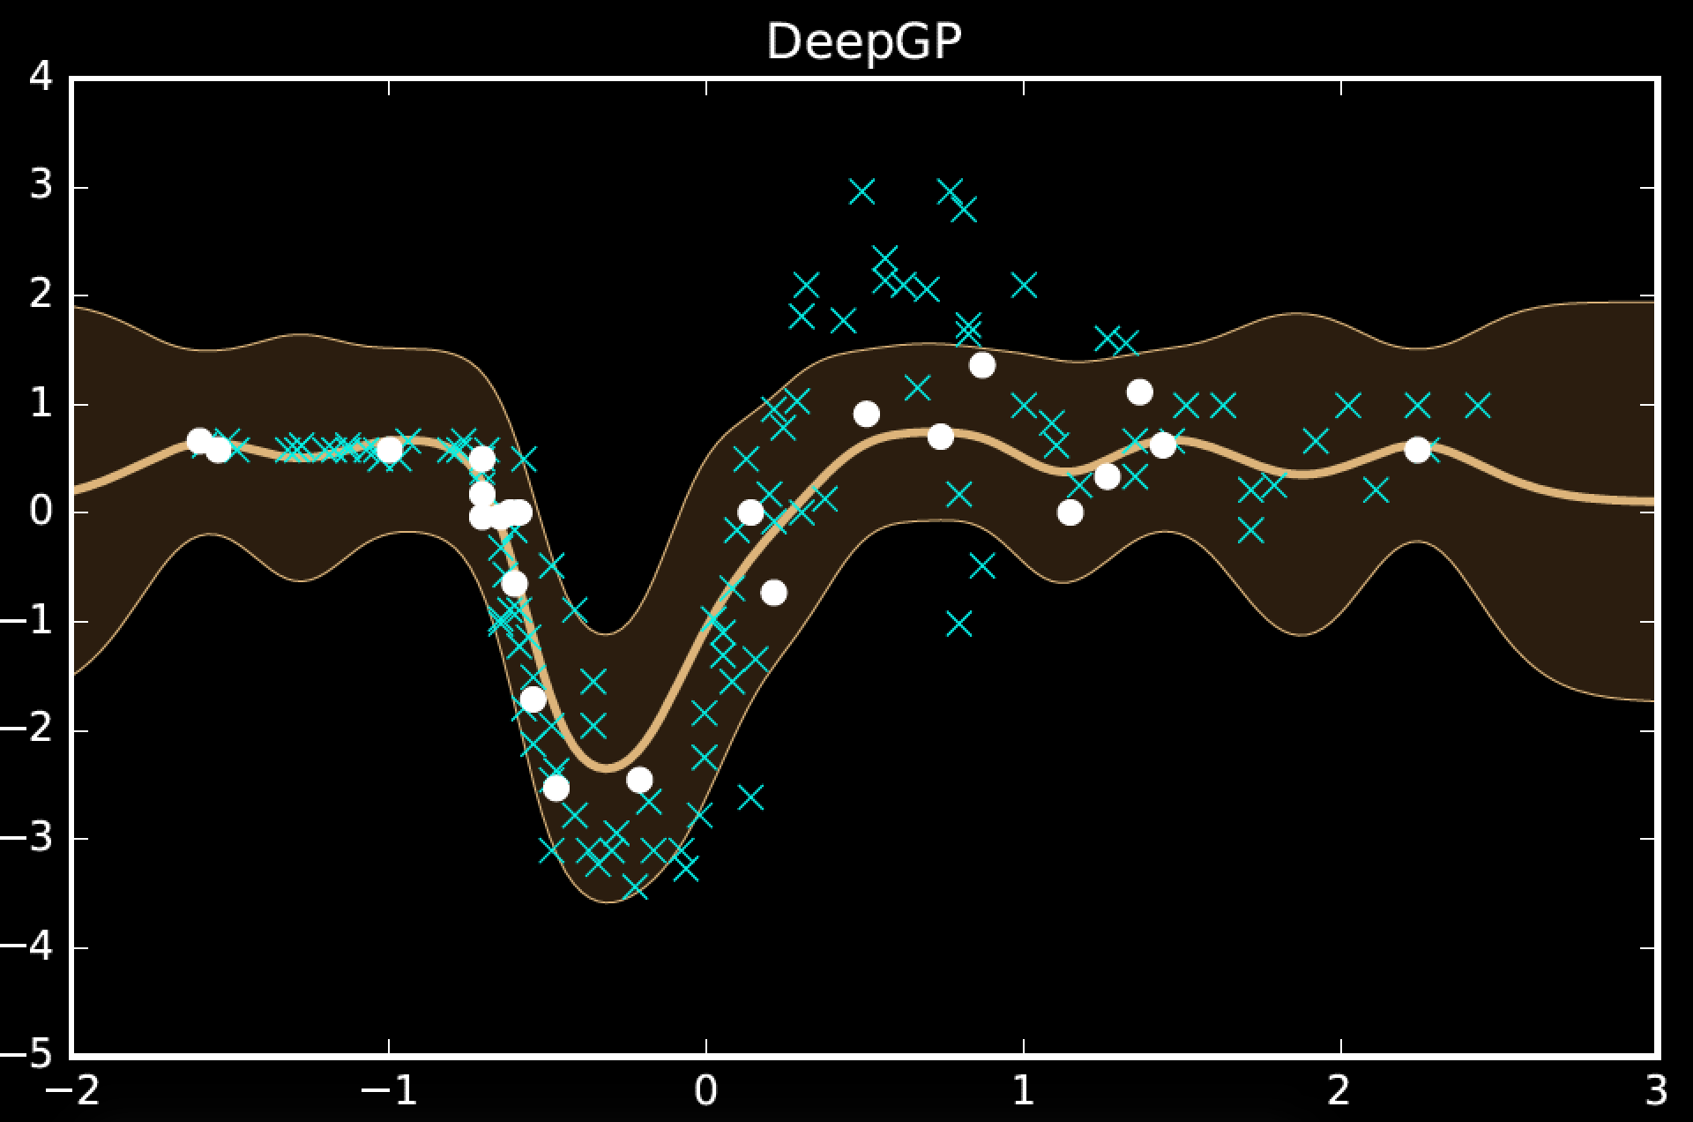
2

Slide 31
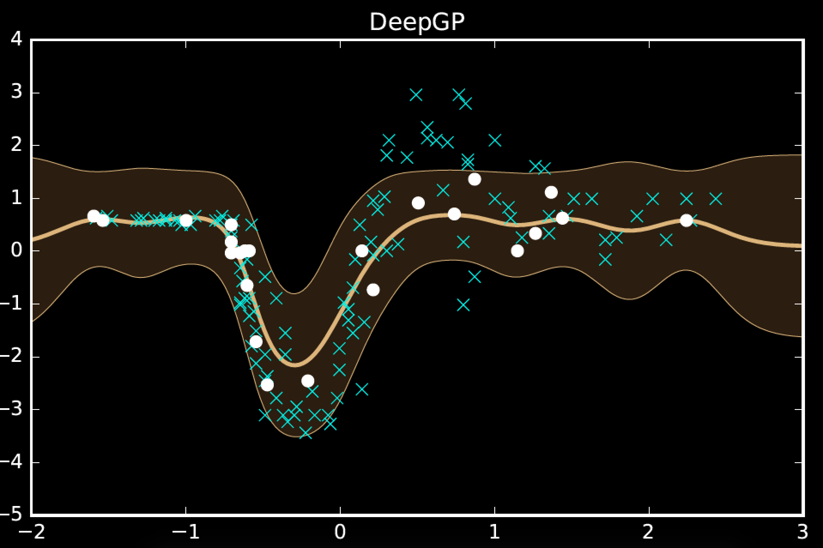
3

Slide 32
model | MSE (train) | MSE (test)
mlp (200 iters) | 108.5 | 1185.1
mlp (converged) | 24.0 | 1338.2
gp | 59.2 | 1095.4
deep gp (2) | 146.2 | 833.7
deep gp (3) | 182.5 | 843.6
One hundred hidden nodes, one hundred inducing points

Slide 33
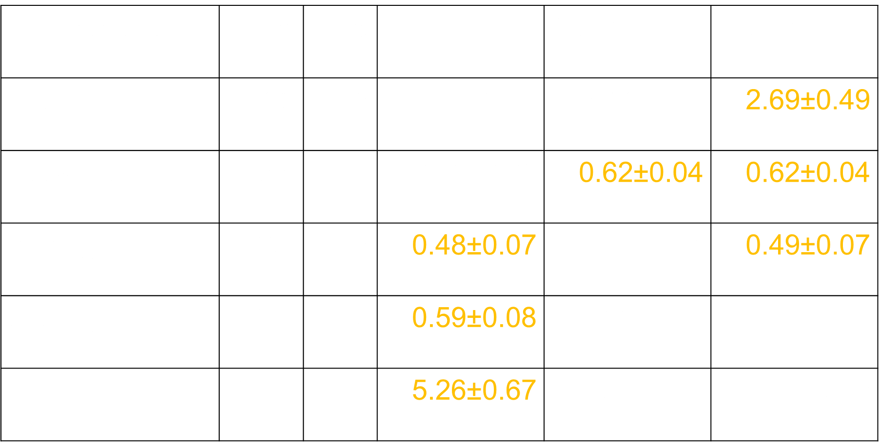
Regression
data set | $$n$$ | $$p$$ | GP | Sparse GP | Deep GP
housing | 506 | 13 | 2.78±0.54 | 2.77±0.60 | 2.69±0.49
redwine | 588 | 11 | 0.72±0.06 | 0.62±0.04 | 0.62±0.04
energy1 | 768 | 8 | 0.48±0.07 | 0.50±0.07 | 0.49±0.07
energy2 | 768 | 8 | 0.59±0.08 | 1.66±0.21 | 1.39±0.49
concrete | 1030 | 8 | 5.26±0.67 | 5.81±0.62 | 5.66±0.62

Slide 34
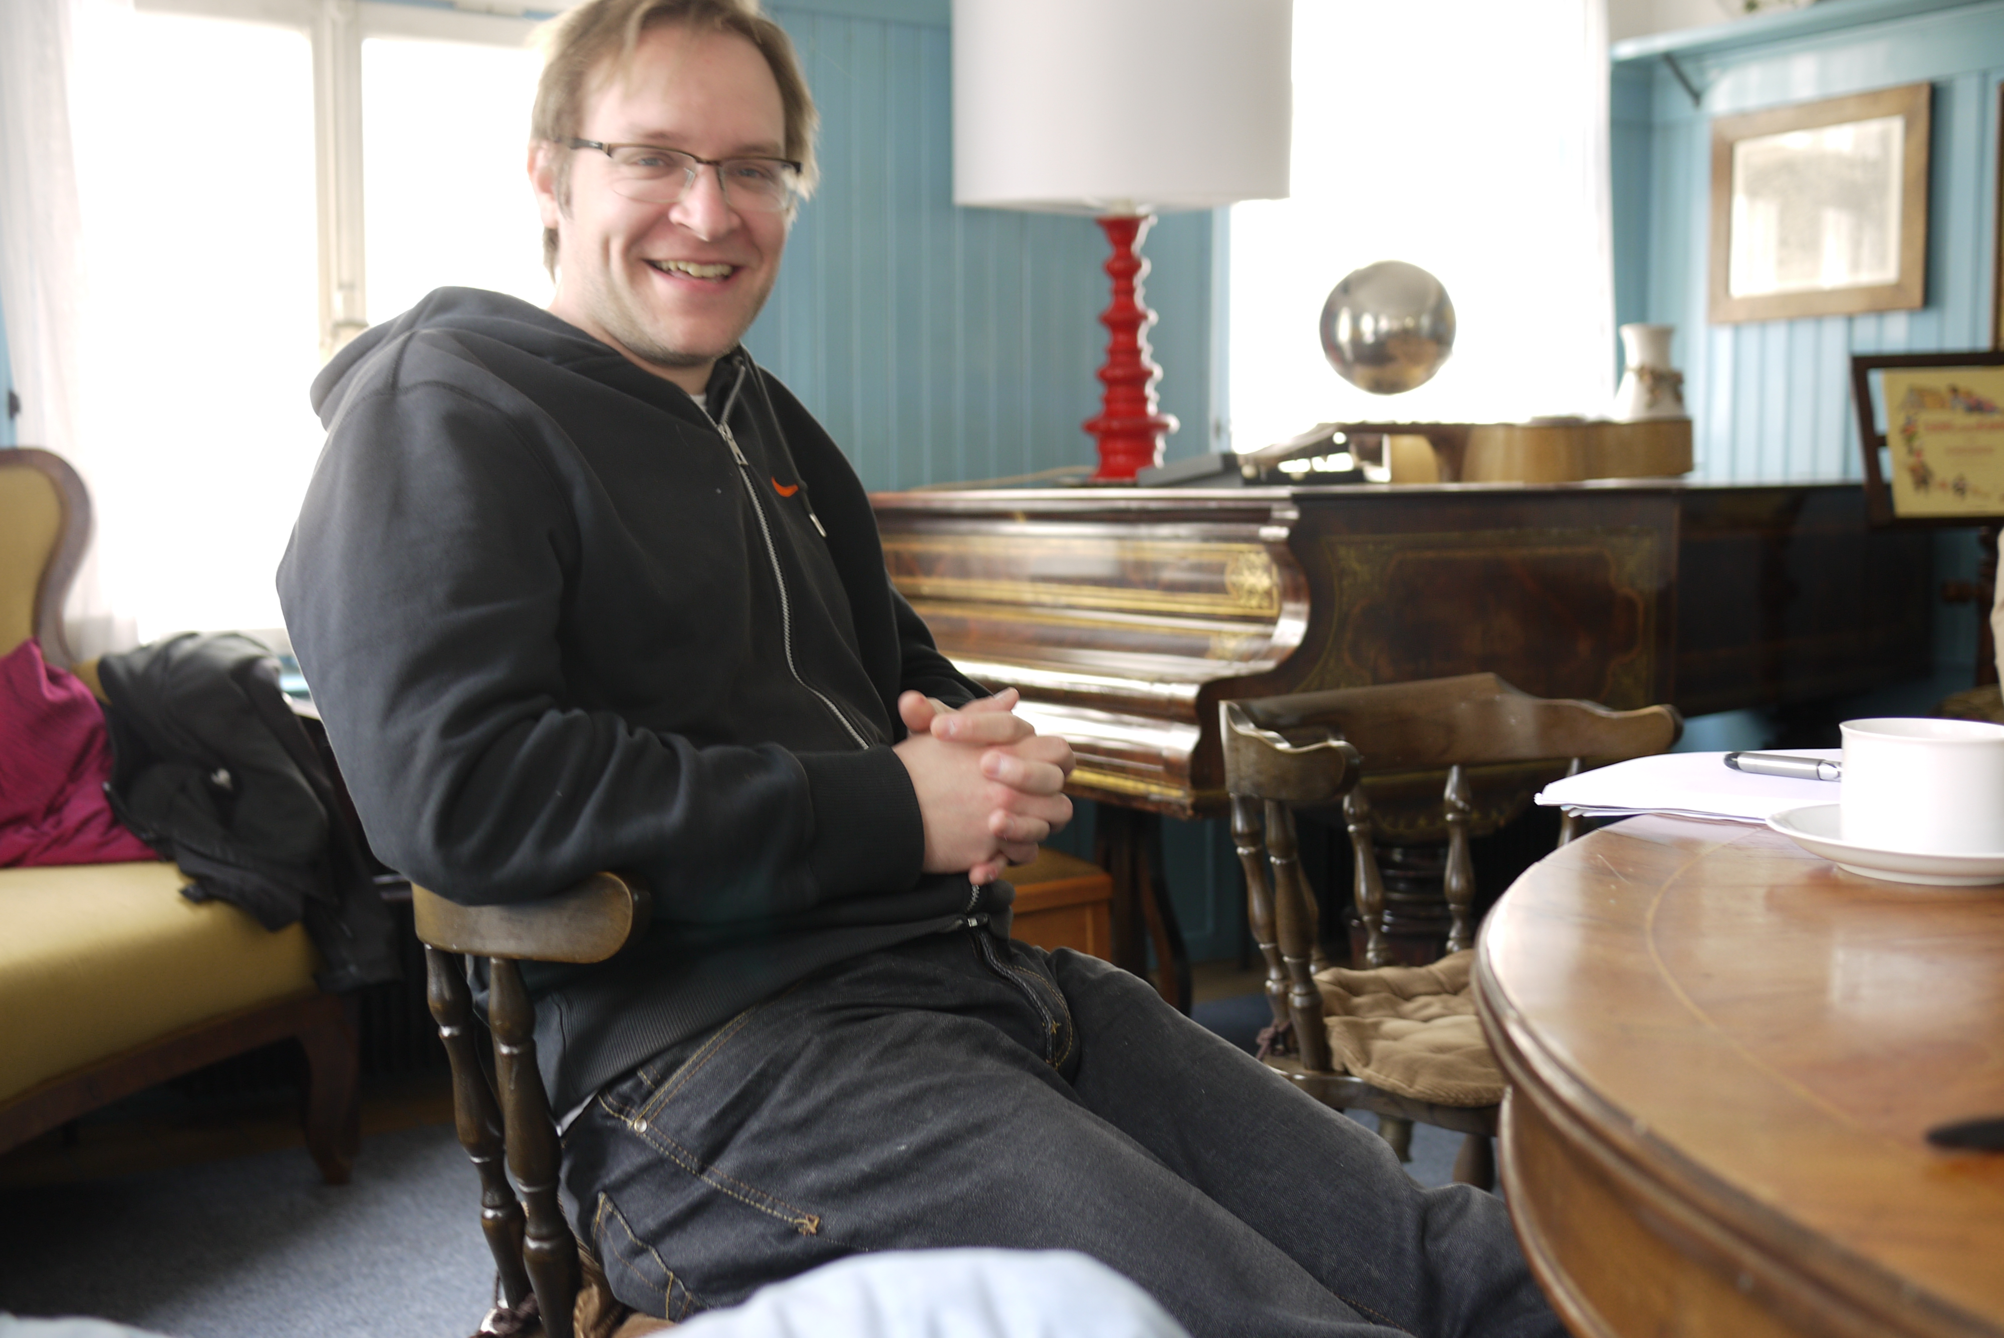
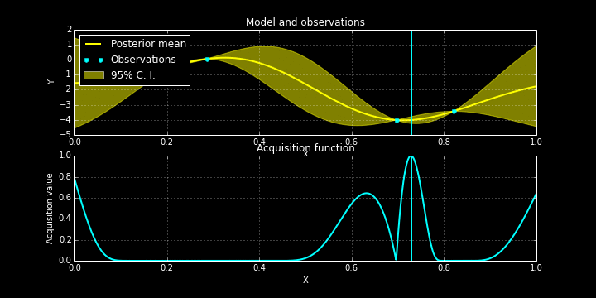
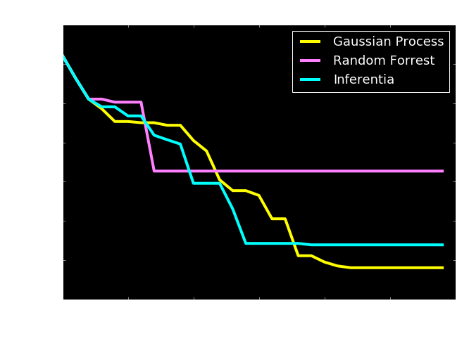
Bayesian Optimization
Check http://sheffieldml.github.io/GPyOpt/

Slide 35
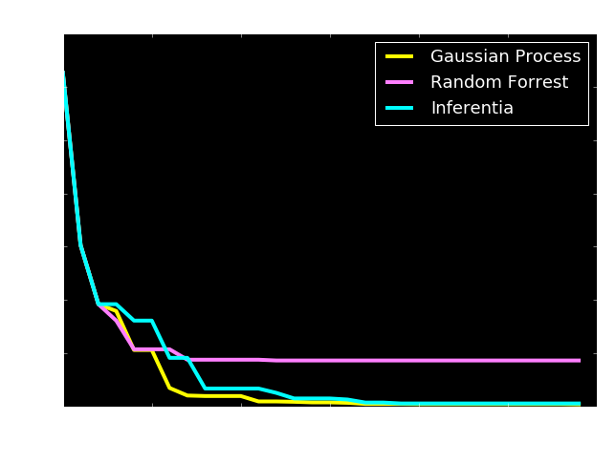
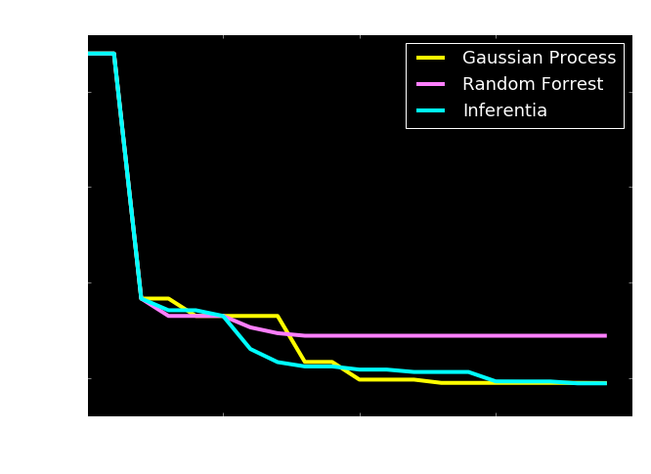
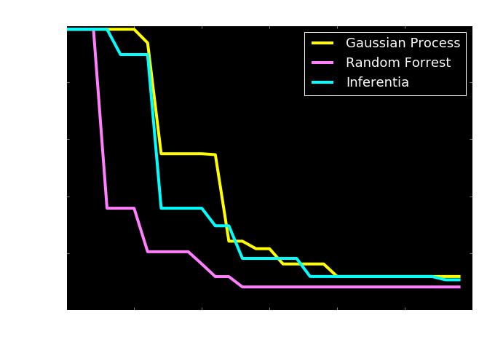
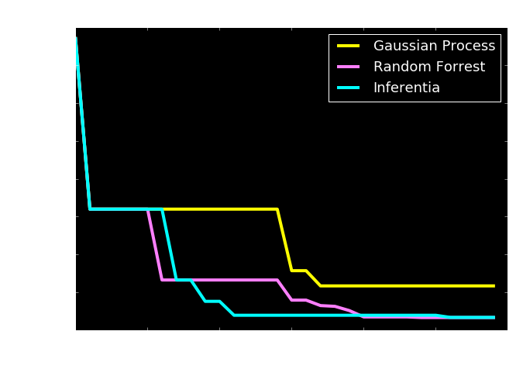

Slide 36
Use Abstraction for Complex Systems
High Level Ideas
Stratification of Concepts
Low Level Mechanisms
Notes:
In this slide I’m going to use the layered model of network systems to describe the challenges of understanding complex systems in the physical world such as biological systems and neuroscience. I’ll give an analogy: imagine trying to understand the internet when you only have measurements of the cables and access to YouTube.

Slide 37
Example: Motion Capture Modelling
Notes:
I’ll give a quick demonstration of the deep Gaussian process (or show a video) probably on the motion capture. This one involves walkers and runners.

Slide 38
MATLAB Demo
demo_2016_04_28_amazon.m

Slide 39
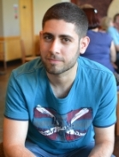
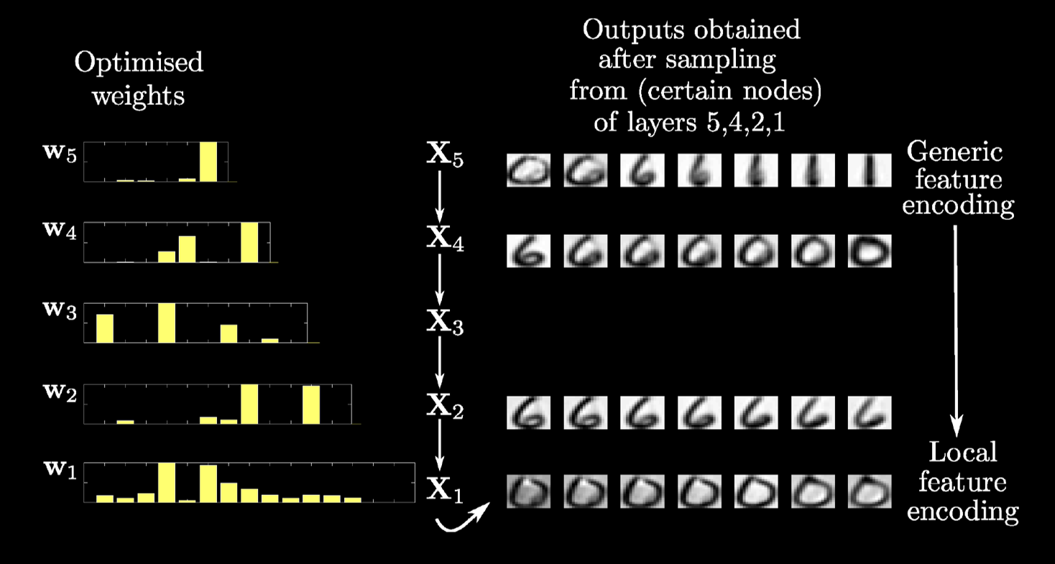
Modelling Digits
Notes:
This one involves a structure that is learnt to model digits.

Slide 40
MATLAB Demo
demo_2016_04_28_amazon.m

Slide 41


Slide 42
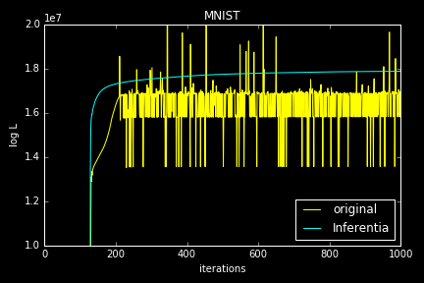
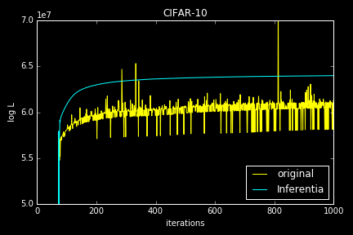
Numerical Issues

Slide 43

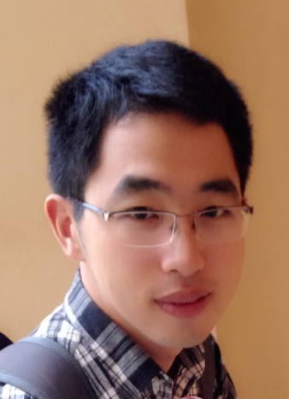

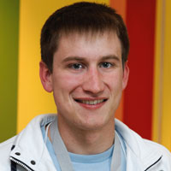
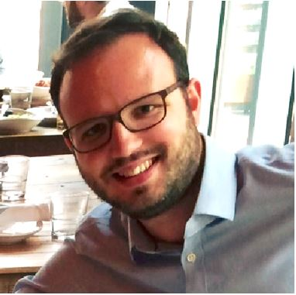
Health
Complex system
Scarce data
Different modalities
Poor understanding of mechanism
Large scale
genotype
environment
epigenotype
State of health
clinical tests
gene expression
Organ states
treatment
clinical notes
Cell states
survival analysis
PLoS Comp Bio, Nature Communications
biopsy
X-ray
biopsy
X-ray

Slide 44
To Find Out More
Gaussian Process Summer School
12th-15th September 2016 in Sheffield
This year in parallel with/themed as a UQ orientated school (co-organisation with Rich Wilkinson)
Occurring alongside ENBIS Meeting
http://gpss.cc/

Slide 45
Future
Methodology
Deep GPs (also current)
Latent Force Models (current but dormant)
Latent Action Models and Stochastic Optimal Control (new)
Probabilistic Geometries (starting)
Exemplar Applications
Health and Biology (existing)
Developing world (existing)
Robotics at different scales (starting)
Perception: vision (dormant) haptic (new)

Slide 46
Summary
Complex systems:
‘big data’ is too ‘small’.
The data are not enough.
Need data efficient methods
http://www.theguardian.com/media-network/2016/jan/28/google-ai-go-grandmaster-real-winner-deepmind
Solutions:
Hybrid mechanistic-empirical models
Structured models for automated data assimilation

Slide 47
Thank you
Neil Lawrence
http://inverseprobability.com
@lawrennd
Notes:
Thank you.

Slide 48
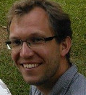

The Digital Oligarchy
Response to concentration of power with data
CitizenMe
London based start up
User-centric data modelling
New challenges in ML
Integration of ML, systems, cryptography.
Notes:
Also of interest: resolving the data liquidity problem (this could go into an appendix if the talk is too long). This means providing methods that respect user privacy. We cannot do this if our methods constantly require all data to be assimilated. Learning needs to be distributed across the population and in control of the users.

Slide 49
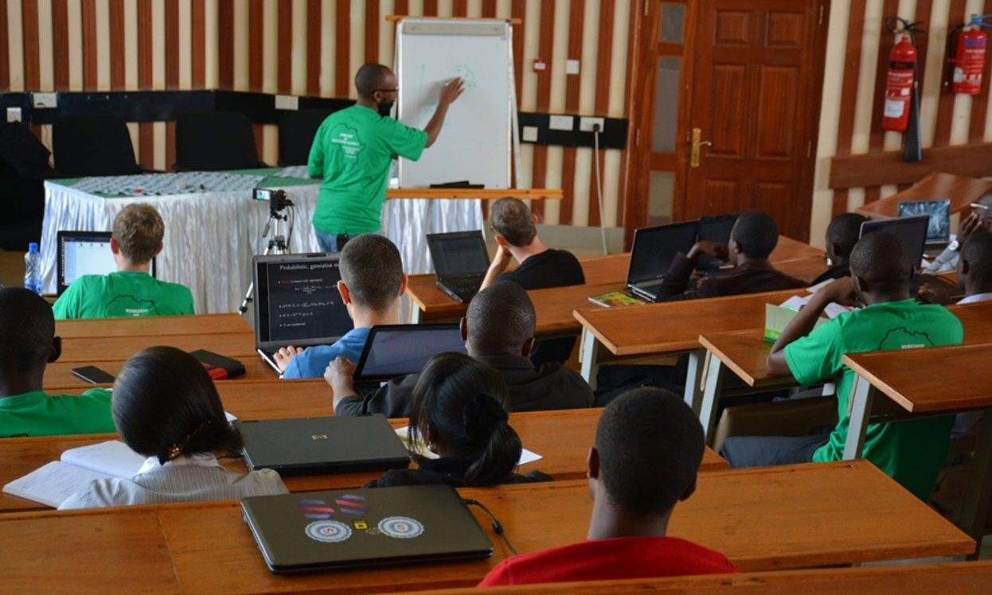
Open Data Science and Africa
Challenge
“Whole pipeline challenge”
Make software available
Teach summer schools
Support local meetings
Publicity in the Guardian
Opportunities to deploy pipeline solution
Notes:
Talk about why Africa is an interesting domain for deploying machine learning models, particularly given the context of the lack of infrastructure there and the possiblities for deploying solutions that are actually more efficient than those we have in Europe. The need to work with systems designers and cryptographers.
Uncertainty and modelling often critical in resource limited environments when a proper statistical design can not be undertaken due to cost.

Slide 50
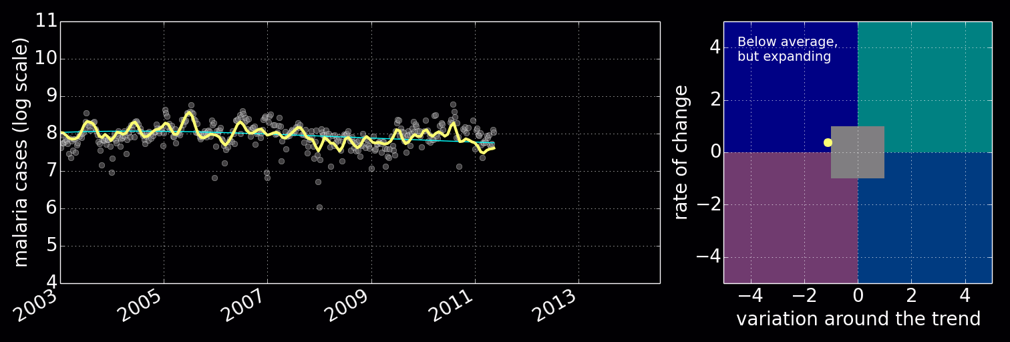
Disease Incidence for Malaria
Notes:
Here I’ll use the example of disease monitoring in Uganda to describe the utility of these models in practice. I’ll relate what we need to do in resource deprived environments with a classical epidemiological approach (which would involve a randomized survey). The importance of modelling becomes apparent when the data itself is not randomized.

Slide 51
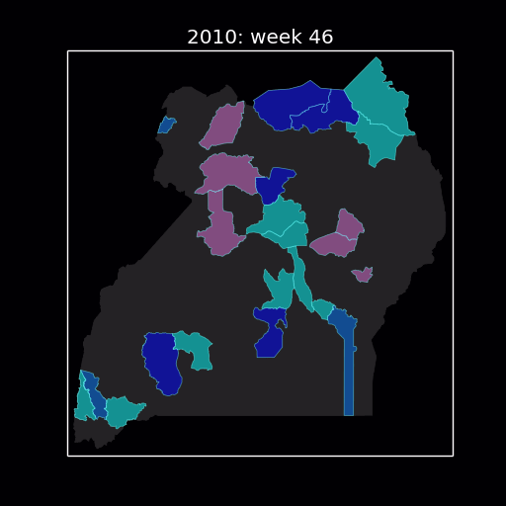
Uganda
Spatial models of disease
Notes:
Here I’ll use the example of disease monitoring in Uganda to describe the utility of these models in practice. I’ll relate what we need to do in resource deprived environments with a classical epidemiological approach (which would involve a randomized survey). The importance of modelling becomes apparent when the data itself is not randomized.

Slide 52
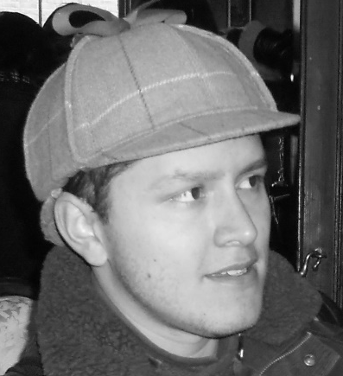
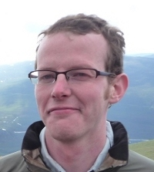

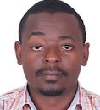
Deployed with UN Global Pulse Lab
http://pulselabkampala.ug/hmis/
Notes:
Possibly show a quick demo of the site Ricardo worked on with UN global pulse.

